Slide 1
Entity FrameWork (EFW)
for C #

Slide 2
EFW -History
Prior to .NET 3.5, we (developers) often used to write Active Data Access Object (ADO.NET) code or Enterprise Data Access Block to save or retrieve application data from the underlying database.
Use to open a connection to the database
Create a DataSet to fetch or submit the data to the database
Convert data from the DataSet to .NET objects or vice-versa to apply business rules.
Alternative
Microsoft has provided a framework called "Entity Framework" to automate all these database related activities for your application.

Slide 3
EFW
Entity Framework is an open-source Object Relation Model (ORM) framework for .NET applications supported by Microsoft.
Focus on data using objects of domain specific classes without focusing on the underlying database tables and columns where this data is stored.
With the Entity Framework, developers can work at a higher level of abstraction when they deal with data, and can create and maintain data-oriented applications with less code compared with traditional applications.
Official Definition: “Entity Framework is an object-relational mapper (O/RM) that enables .NET developers to work with a database using .NET objects. It eliminates the need for most of the data-access code that developers usually need to write.”

Slide 4
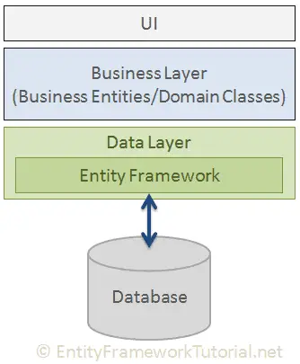
EFW

Slide 5
EFW- Use for
Entity Framework is used in the following scenarios.
Create an MVC web app.
Set up the site style.
Install Entity Framework 6.
Create the data model.
Create the database context.
Initialize DB with test data.
Set up EF 6 to use LocalDB.
Create controller and views

Slide 6
Main Features
Cross-platform: EF Core is a cross-platform framework which can run on Windows, Linux and Mac.
Modelling: EF (Entity Framework) creates an EDM (Entity Data Model) based on POCO (Plain Old CLR Object) entities with get/set properties of different data types. It uses this model when querying or saving entity data to the underlying database.
Querying: EF allows us to use LINQ queries (C#/VB.NET) to retrieve data from the underlying database. The database provider will translate this LINQ queries to the database-specific query language (e.g. SQL for a relational database). EF also allows us to execute raw SQL queries directly to the database.
Change Tracking: EF keeps track of changes occurred to instances of your entities (Property values) which need to be submitted to the database.
Saving: EF executes INSERT, UPDATE, and DELETE commands to the database based on the changes occurred to your entities when you call the SaveChanges() method. EF also provides the asynchronous SaveChangesAsync() method.
Concurrency: EF uses Optimistic Concurrency by default to protect overwriting changes made by another user since data was fetched from the database.
Caching: EF includes first level of caching out of the box. So, repeated querying will return data from the cache instead of hitting the database.

Slide 7
EFW- Features
Transactions: EF performs automatic transaction management while querying or saving data. It also provides options to customize transaction management.
Built-in Conventions: EF follows conventions over the configuration programming pattern, and includes a set of default rules which automatically configure the EF model.
Configurations: EF allows us to configure the EF model by using data annotation attributes or Fluent API to override default conventions.
Migrations: EF provides a set of migration commands that can be executed on the NuGet Package Manager Console or the Command Line Interface to create or manage underlying database Schema.

Slide 8
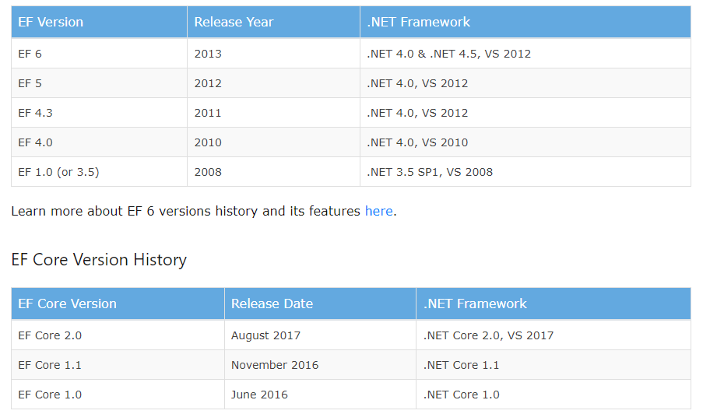
EFW- Version History

Slide 9
EFW- Approaches
Code-First
The user has to prepare by giving them the properties representing the table fields to determine the structure of the database.
Database First
Use has to model a pre-existing database (and therefore, to derive from it our objects)
Question?
Is there any Contract First Approach?

Slide 10
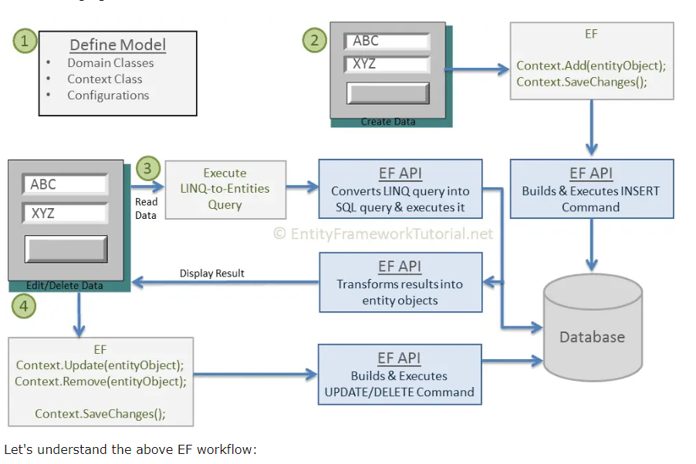
CRUD Workflow in EFW

Slide 11
Steps
Define your model. Defining the model includes defining your domain classes, context class derived from DbContext, and configurations (if any).
EF will perform CRUD operations based on your model.
To insert data, add a domain object to a context and call the SaveChanges() method. EF API will build an appropriate INSERT command and execute it to the database.
To read data, execute the LINQ-to-Entities query in your preferred language (C#/VB.NET). EF API will convert this query into SQL query for the underlying relational database and execute it. The result will be transformed into domain (entity) objects and displayed on the UI.
To edit or delete data, update or remove entity objects from a context and call the SaveChanges() method. EF API will build the appropriate UPDATE or DELETE command and execute it to the database.

Slide 12
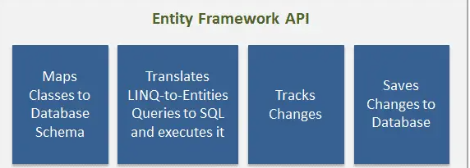
EFW- API

Slide 13
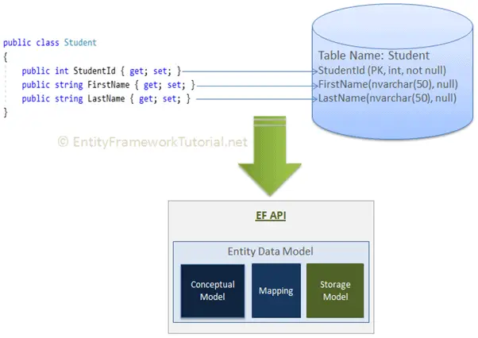
2. Entity Data Model
DM is an in-memory representation of the entire metadata:
conceptual model
storage model
and mapping between them.

Slide 14
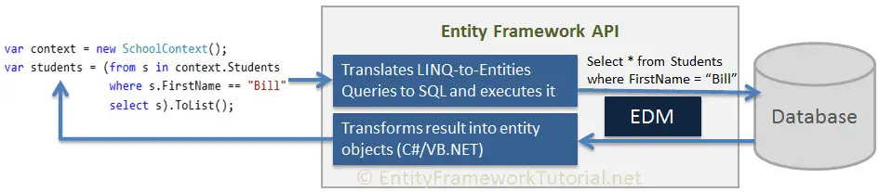
3. Querying

Slide 15
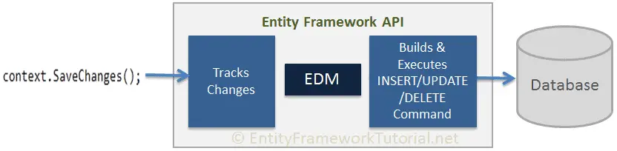
4. Saving

Slide 16
References
1.https://learn.microsoft.com/en-us/aspnet/mvc/overview/getting-started/getting-started-with-ef-using-mvc/creating-an-entity-framework-data-model-for-an-asp-net-mvc-application
2. https://www.c-sharpcorner.com/article/entity-framework-introduction-using-c-sharp-part-one/

